Slide 1
Open-endedness in Debugging

Slide 2
Let’s start with a question.
You walk up to one of your students… The student is debugging… You want your student to figure out why their code is broken…
In the flow of the conversation, what do you think you might say? Try to capture your authentic voice, what you would really say/do in this moment.
Notes:
What error is popping up? What exactly is not working with your code? When did the code stop working?

Slide 3
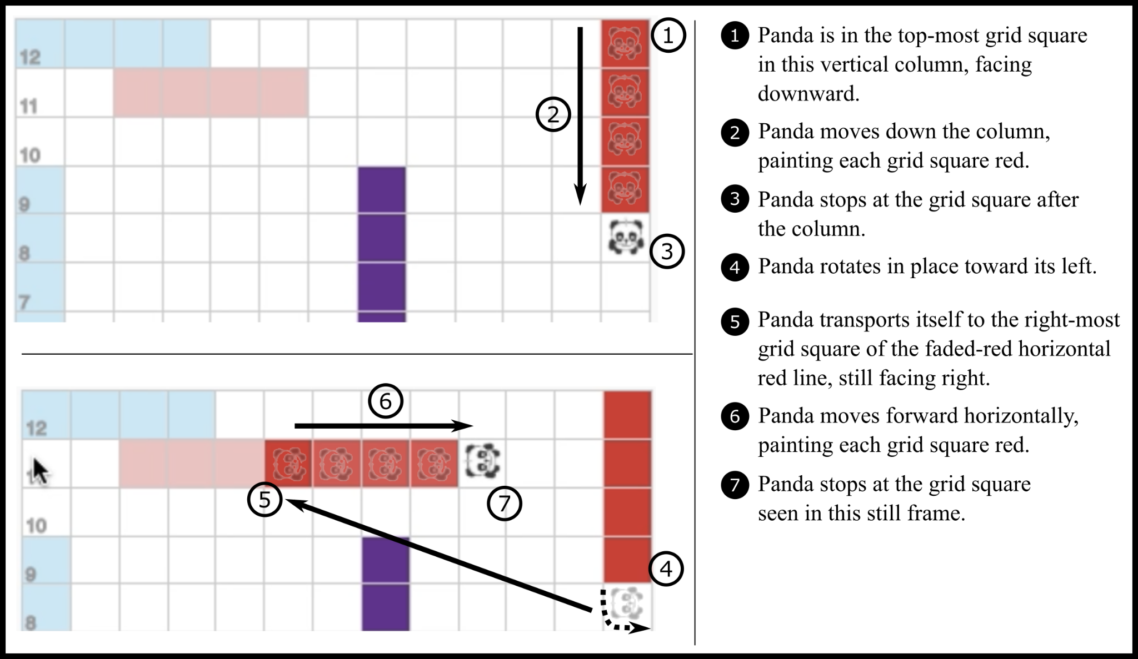
Let’s start by looking at some code...

Slide 4
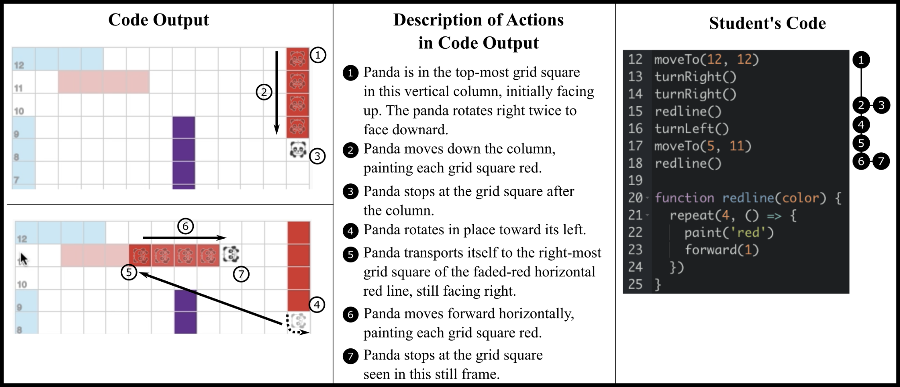

Slide 5
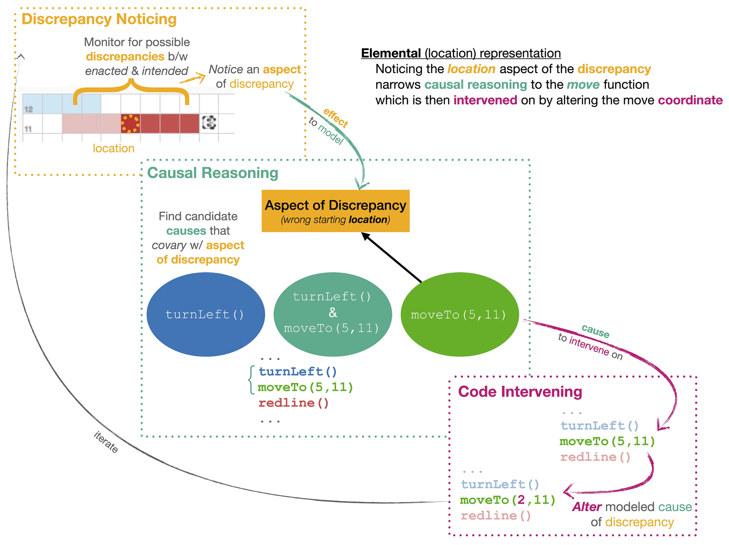

Slide 9
Let’s revisit the earlier prompt.
You walk up to one of your students… The student is debugging… You want your student to figure out why their code is broken…
In the flow of the conversation, what did you say? Compare what you said with this idea of open-ended pathways in debugging.
Can you think of a story where you encountered some kind of challenge around the open-endedness of debugging?

Slide 10
We have noticed that there is a strong tendency in the debugging educational research literature to think about debugging as the search for a singular cause (bug)

Slide 11
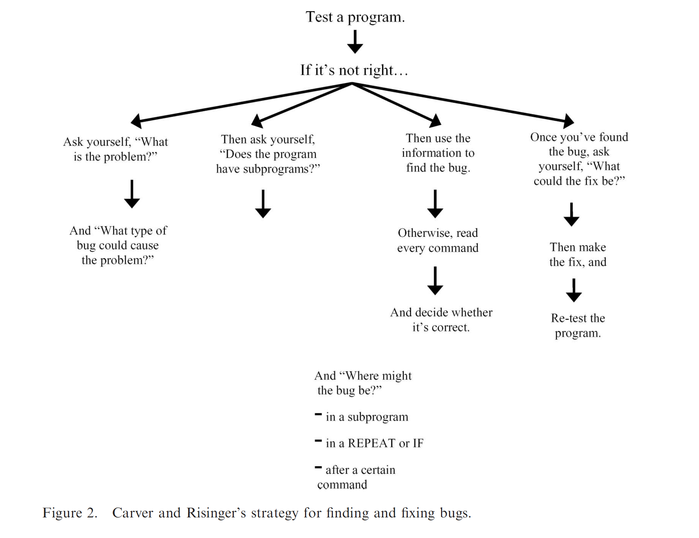
(1987)

Slide 12
Ko et al. (2019)
# If you need help finding the problem, ask for help. Find what your program is doing that you do not want it to do # Write the line number inside of the program # and separate with commas. SET 'possibleCauses' to any lines of the program that might be responsible for causing that incorrect 'behavior' FOR EACH 'cause' IN 'possibleCauses' Navigate to 'cause' # Ask for help if you need guidance on how. Look at the code to verify if it causes the incorrect behavior IF 'cause' is the cause of the problem # If you need help finding the problem, ask for help. Find a way to stop 'cause' from happening # Ask for help if you need guidance on how. Change the program to stop the incorrect behavior # Ask for help if you need guidance on how. Mark the task as finished RETURN nothing IF you did not find the cause Ask for help finding other possible causes Restart the strategy RETURN nothing

Slide 13
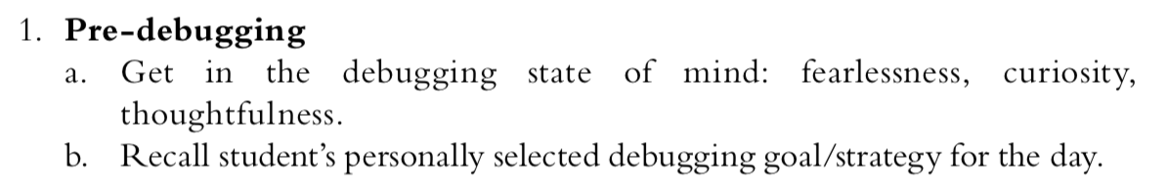
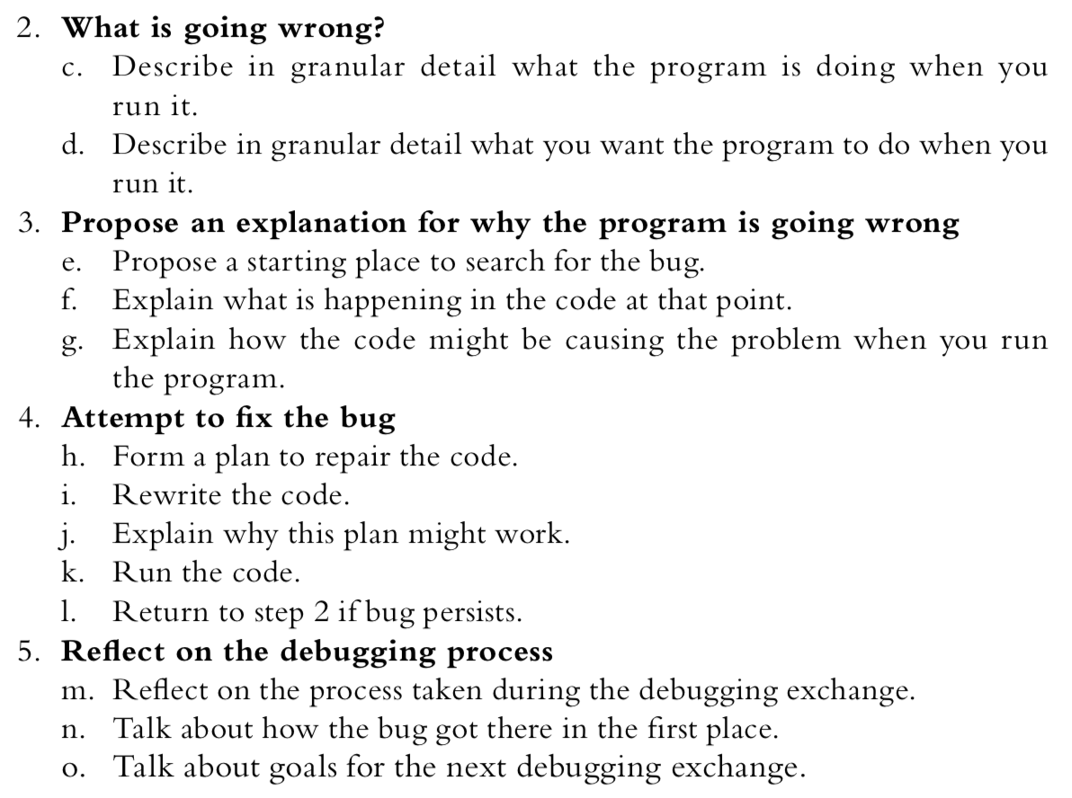
DeLiema et al. (2020)

Slide 14
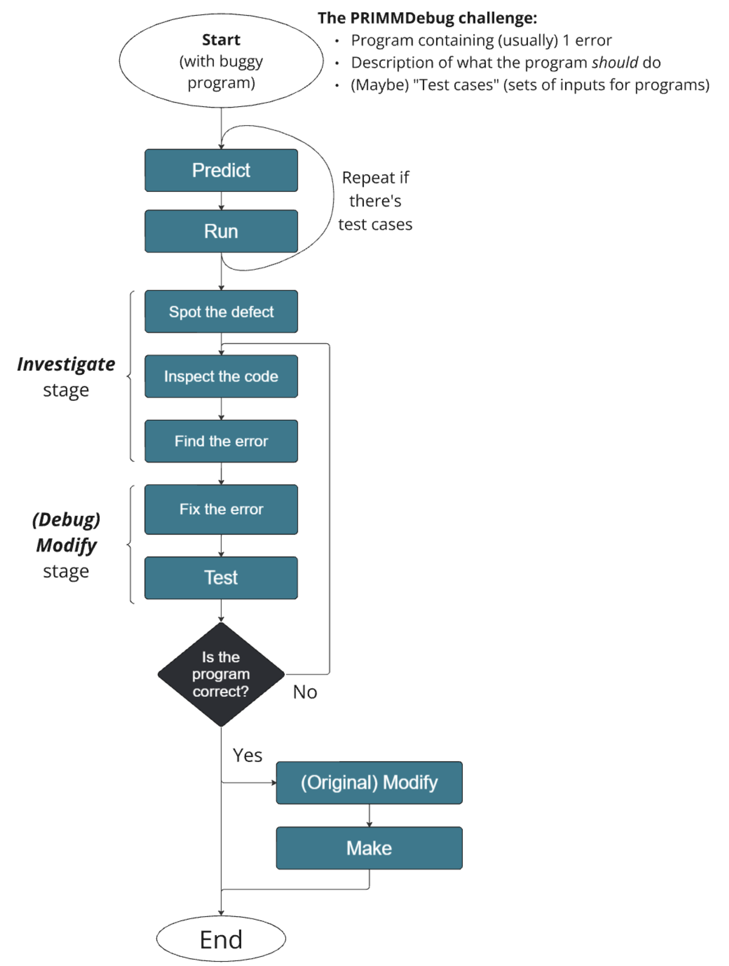
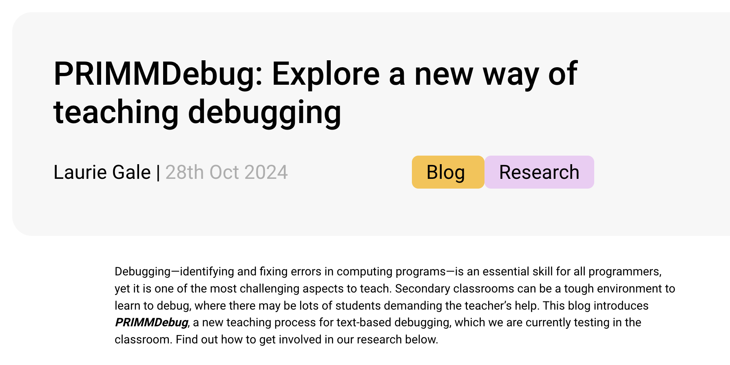

Slide 15
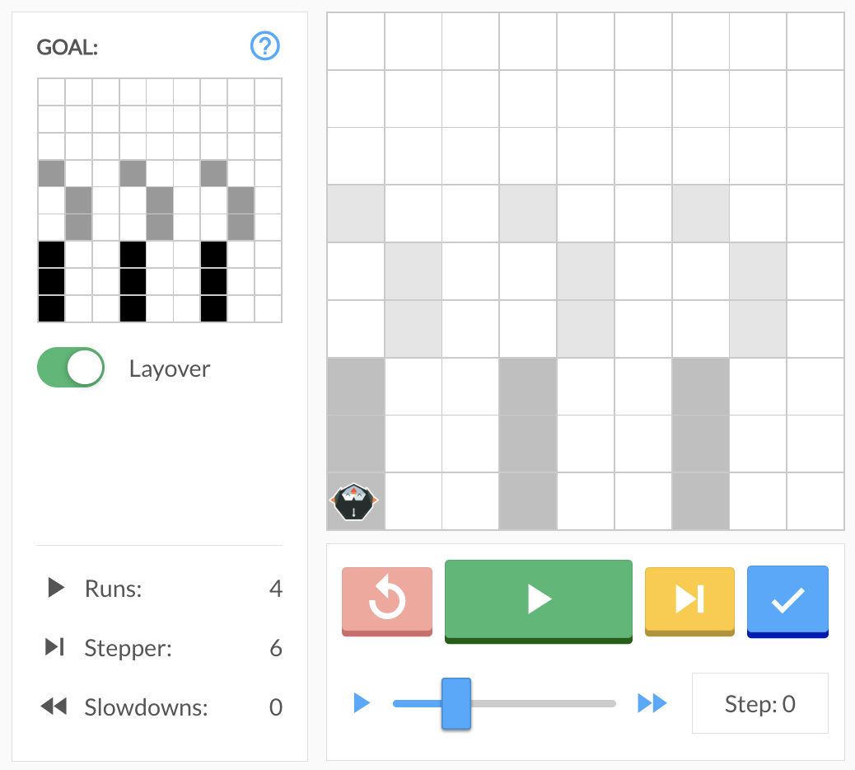
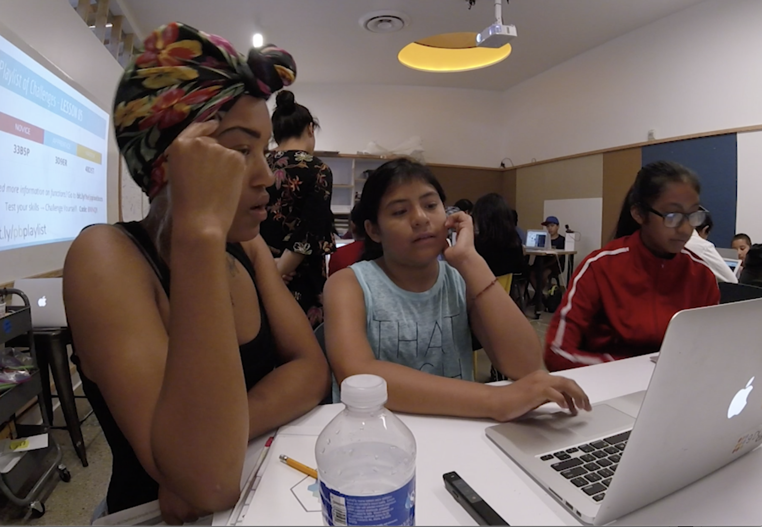
How do these dynamics play out in the classroom?
INSTRUCTOR
Ana
Mel
(all pseudonyms)

Slide 16
But first: Norms for watching video
Watch all the way through.
Watch again, pause when folks request, rewatch, talk, comment.
Try not to pause the video for more than 5 minutes.
Kinds of observations we might share:
What are you seeing happening in the video?
What are you seeing happening in the video with respect to open-ended debugging pathways?
What stories come to mind from your classroom when you see this?
What teaching ideas does this clip raise for you?

Slide 17
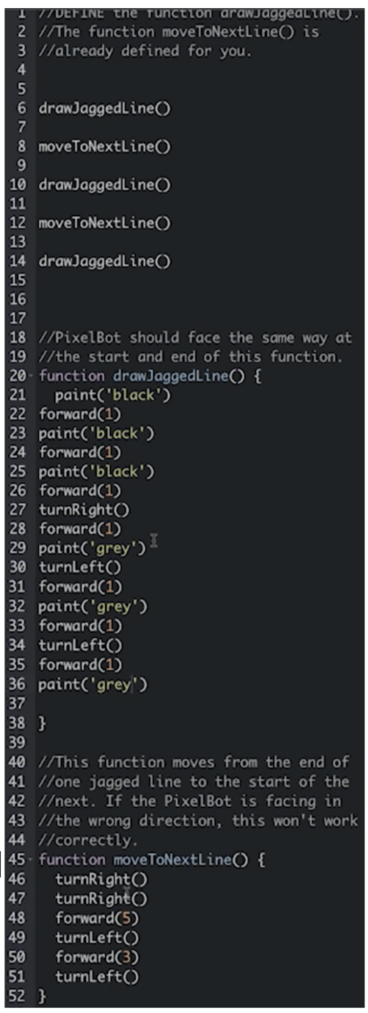
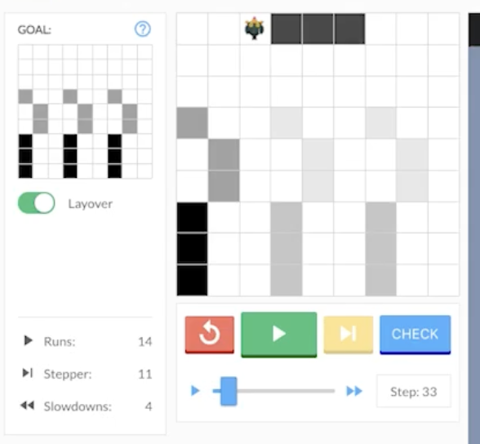
INSTRUCTOR
Ana
Mel
Starter code given to Ana.
(all pseudonyms)
Starter code given to Ana.

Slide 18
INSTRUCTOR
Ana
Mel
Starter code given to Ana.
Code that Ana wrote.
(all pseudonyms)
Starter code given to Ana.

Slide 19
Watch the video clip.
Any clarifying questions?
Re-watch the clip.

Slide 20
[ ] | Left and right brackets indicate overlapping talk or action
(0.2) | Numbers in parentheses indicate pause in seconds
(.) | Dot in parentheses indicates a brief pause
word- | A dash after a sound indicates a beat between utterances
:: | Double colon indicates prolongation of prior sound
↑↓ | Upward and downward arrow indicate a shift into higher or lower pitch, respectively
? | Question mark indicates a rise in pitch
WORD | Upper case letters indicate louder sounds
°word° | Degree signs surrounding talk indicates softer sounds
((action)) | Description in bold, italicized font and surrounded by two pairs of parentheses indicates action
> < | Right then left carats indicate hurried or faster talk
(word) | Parentheses containing word(s) indicate possibilities for what was said
( ) | Empty parentheses indicate undecipherable speech. Wider space indicates a longer period of unknown speech.

Slide 21
Watch the video clip.
Any clarifying questions?
Re-watch the clip.
What are you seeing in this video clip with respect to our focal theme (above)?
Re-watch the clip.
Now that you’ve watched a few times looking out for our focal theme…free-write for a few minutes.

Slide 22
Classroom application
Ideas for consideration that might help you think about how you frame open-endedness when debugging:
What is the learning objective? What do you hope students master?
What’s the topic of the lesson?
What is the goal of the programming task?
What do you think got the student tripped up with their code in the first place, and do you or they care if it recurs?
What is the students’ current skill level with coding?
How does the student want to fix the code?
What’s the pathway to the quickest fix?
What is the most elegant fix?
What pathway would teach the student the most about coding?
Many others...
How do you want to think about open-endedness in your teaching? Start brainstorming ideas that you can implement.

Slide 23
Classroom application brainstorm.
Notes from our discussion…

